Slide 1
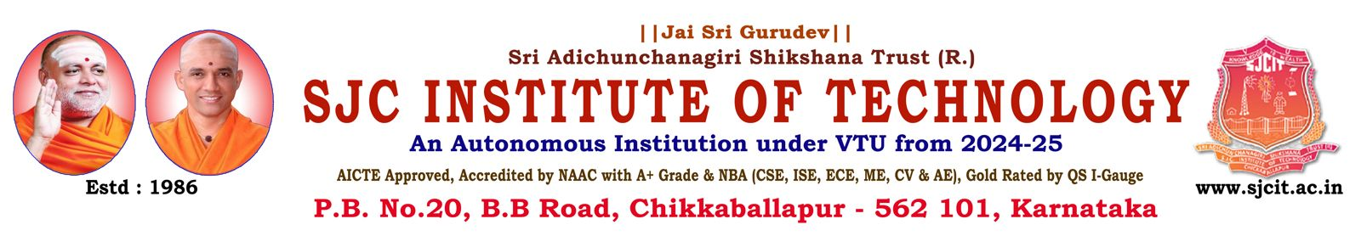
DEPARTMENT OF ARTIFICIAL INTELLIGENCE AND DATA SCIENCE
Major project Review On
“Real-Time Hand Gesture Interface for UAV
Control Using PX4 Autopilot”
Presented By:
Preetham Gowda S
S Yashas
T Kiran
Yuvaraj B
1SJ23AD041
1SJ23AD048
1SJ23AD055
1SJ23AD063
Under the guidance of:
Mr. Sreenivas G S
Asst Professor
Dept of AI &DS,SJCIT

Slide 2

ABSTRACT
Intelligent drone control system that combines gesture recognition, face detection, and autonomous flight using artificial intelligence. The system allows users to control a drone without any physical controller by using simple hand gestures captured through a camera. It also incorporates face detection and tracking, enabling the drone to follow a user automatically. The system is integrated with a PX4 autopilot simulator and communicates using MAVSDK for real-time control. It includes features such as auto takeoff, landing, hover stabilization, and gesture-based directional movement.

Slide 3
PROBLEM STATEMENT
Traditional drone systems rely heavily on remote controllers, which require user training and are not very intuitive for beginners. Although some existing systems provide gesture control or face detection, these features are usually implemented separately and are not integrated with autonomous flight capabilities. This project addresses these limitations by combining gesture-based control for movement, face detection and tracking for intelligent interaction, and autonomous drone functions such as takeoff, landing, and hover. Additionally, real-time communication is established using MAVSDK to ensure smooth and responsive control. By integrating all these features into a single system, the proposed solution enhances usability, reduces manual effort, and provides a more natural and efficient human-drone interaction.

Slide 4
INTRODUCTION
In recent years, drones have become widely used in various fields such as surveillance, delivery, agriculture, and rescue operations. However, most drones still rely on manual controllers, which can be complex and require training. To overcome this limitation, this project introduces an AI-based gesture and face-controlled drone system. The system uses computer vision techniques to detect hand gestures and facial features through a webcam. Based on these inputs, the drone performs actions such as takeoff, landing, and movement. The integration of gesture control with autonomous flight and face tracking makes the system more interactive and intelligent.

Slide 5
LITERATURE SURVEY
SL NO | Feature | Paper Title | Approach Used in Paper | Gap Identified
01 | Obstacle Avoidance | Fast Obstacle Avoidance Motion in Small Quadcopter | Uses FOAM algorithm with camera + LiDAR sensor fusion and probabilistic occupancy mapping for real-time navigation | High computation and focuses only on navigation, no gesture or human interaction
02 | Autonomous UAV | AI-Powered Autonomous UAV for Power Line Inspection | Uses computer vision + GPS waypoint navigation + YOLO-based fault detection for autonomous inspection | No gesture control or real-time human interaction
03 | Communication & Control | Secure Ground Control Station and Communication Architecture in UAV | Uses MAVLink-based communication, PID control, and secure UAV architecture | Focuses only on communication, lacks AI vision and gesture systems
04 | Computer Vision | Using AI Supported Computer Vision on UAVs | Uses deep learning models like CNN & YOLO for object detection and image processing | No integration with drone control or gesture interaction
05 | Surveillance Systems | Intelligent Surveillance Using Drones | Uses AI, sensors, and computer vision for monitoring, tracking, and detection | Lacks user interaction (gesture/face control) and real-time manual override

Slide 6
Existing System
Traditional drone systems rely heavily on remote controllers, which require user training and are not very intuitive for beginners. Most systems depend on manual input, making operation complex and less accessible for non-technical users. In many cases, control accuracy depends on the user’s skill, which can lead to errors during navigation.They also lack flexibility and require constant manual supervision, reducing efficiency in dynamic environments.
Disadvantages
Requires physical remote controller
Not user-friendly for beginners
No natural human interaction
Gesture and face control not integrated
Limited automation features
Requires training to operate

Slide 7
Proposed System
The proposed system presents an AI-based gesture and face-controlled autonomous drone that enables intuitive, touchless interaction without the need for a traditional remote controller. The system uses a webcam to capture real-time video, where OpenCV and MediaPipe are employed to detect hand gestures and facial features. Based on the detected gestures, movement commands such as takeoff, landing, and directional control are generated, while face detection enables the drone to track and follow a user automatically. These commands are transmitted through MAVSDK using the MAVLink protocol to the PX4 autopilot, which executes them within the Gazebo simulation environment. The system also supports autonomous features such as stable hover, smooth navigation, and real-time responsiveness. By integrating gesture control, face tracking, and autonomous flight into a single platform, the proposed system enhances usability, reduces manual effort, and provides a more natural and efficient human-drone interaction.

Slide 8
METHODOLOGY
Input:The system captures real-time video input using a webcam, or by uploading, which continuously records the user’s hand gestures and facial features.
Image Processing:The captured video frames are processed using OpenCV to enhance image quality and prepare them for detection.
Gesture Detection:MediaPipe is used to detect hand marks and identify gestures based on finger count and hand positions. Each gesture is mapped to a specific drone command.
Face Detection and Tracking:The system detects the user’s face and tracks its position in real time. This enables the drone to follow the user automatically.
Command Generation:Based on detected gestures and face position, corresponding control commands such as takeoff, landing, and movement are generated.
Communication:The generated commands are sent to the drone using MAVSDK, which communicates through the MAVLink protocol.
Drone Execution:The PX4 autopilot receives the commands and executes them in the Gazebo simulation environment, controlling the drone’s movement.
Continuous Loop:The system continuously processes input and updates commands in real time to ensure smooth and responsive drone operation.

Slide 9
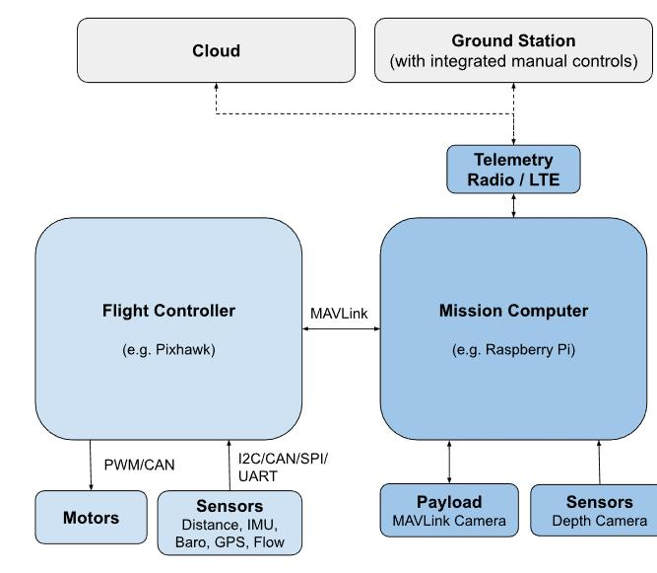
Design:
System Architecture:

Slide 10
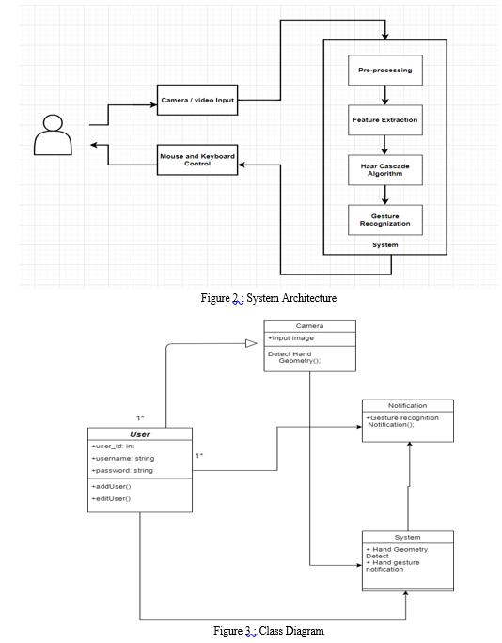

Data Flow:
Class Diagram:
Input (Gesture/Face)
↓
Image Processing (OpenCV)
↓
Detection (MediaPipe)
↓
Command Mapping
↓
MAVSDK Communication
↓
PX4 Processing
↓
Drone Output (Movement)

Slide 11
Proposed Outcomes
Gesture-based drone control without remote
Face detection and automatic following
Autonomous takeoff, landing, and hover
Real-time response system
Smooth drone navigation
User-friendly and interactive system

Slide 12
Project Plan 2.0
🔹 Phase 1: Setup
Install PX4, Gazebo, MAVSDK
Configure environment
🔹 Phase 2: Development
Implement gesture detection
Implement face detection
🔹 Phase 3: Integration
Connect MAVSDK with PX4
Map gestures to commands
🔹 Phase 4: Feature Implementation
Auto hover
Face follow
Gesture control
🔹 Phase 5: Testing
Debug errors
Improve accuracy
🔹 Phase 6: Finalization
Automation using BAT file
Documentation & presentation

